Slide 1

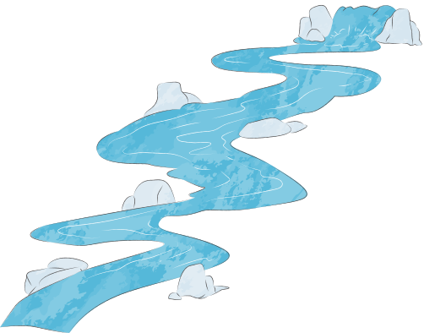
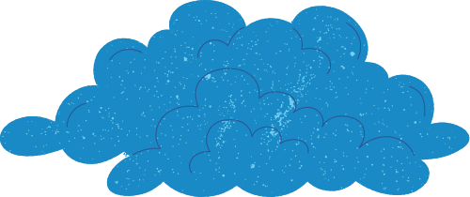
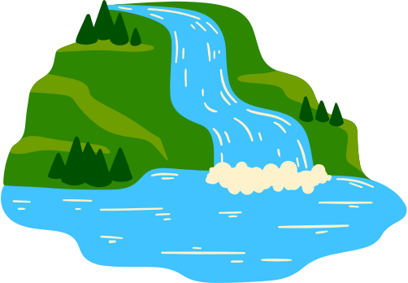
What is a catchment?
A catchment is an area of land where all rain and runoff flow into the same river, lake or wetland. Hills, slopes and natural ridges determine where water travels.
Everything that happens in a catchment affects the water within it.

Slide 2
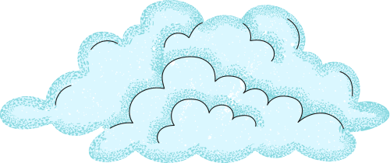
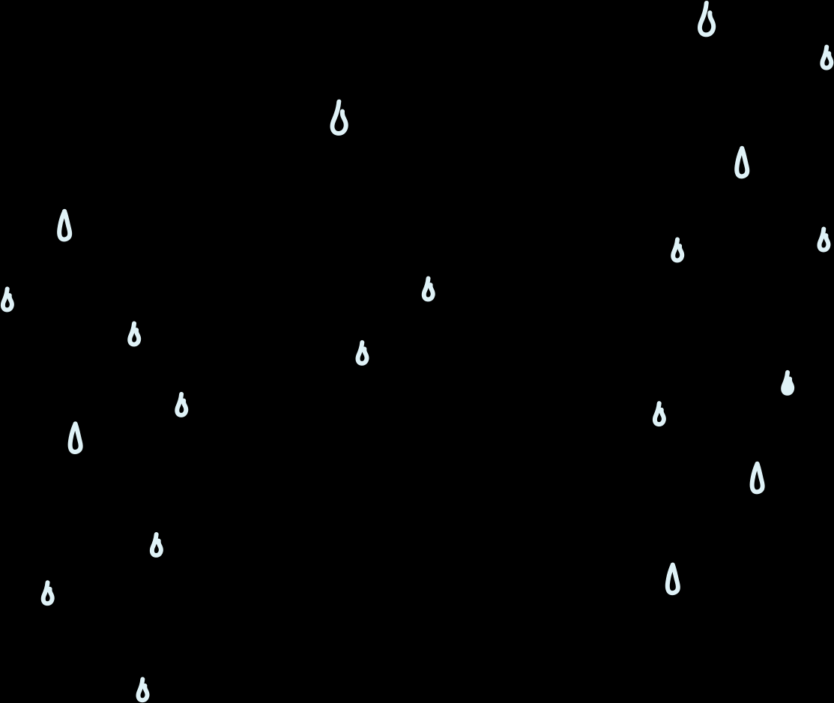
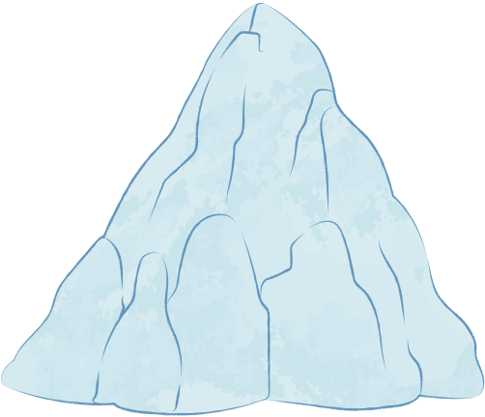

What processes cause water to enter a catchment?
Precipitation: Water falls as rain, hail or snow and enters the catchment.
Infiltration: Some water soaks into the soil. This helps recharge groundwater and aquifers.
Runoff: Water that cannot soak in flows over the land surface into creeks and rivers.

Slide 3
How does water move through a catchment?
Surface flow: Water travels through streams and rivers from higher to lower areas.
Groundwater flow: Water stored underground slowly moves through rocks and sediments, feeding springs and rivers.

Slide 4
Where is water stored in a catchment?
Surface: Water is stored above the ground in rivers, lakes, wetlands and dams. This water moves through the catchment and is used by people, plants and animals.
Groundwater: Water is also stored underground in layers of rock, sand or gravel called aquifers. It fills the spaces between particles and can be pumped up through bores.

Slide 5
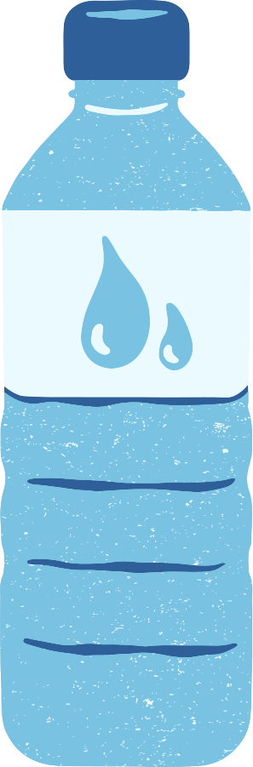
What processes cause water to leave a catchment?
Evaporation: Heat turns water on surfaces back into vapour.
Transpiration: Plants release water vapour from their leaves.
Evapotranspiration: Combined water loss from land and plants.
Outflow: Rivers eventually carry water out of the catchment into another river, lake or the ocean.

Slide 6
What is a catchment?
Complete the diagram of the water cycle, identifying all the processes that influence how water moves through a catchment.
Notes:
Worksheet 2.1

Slide 7
Follow the raindrop!
Using the Global River Runner tool, investigate how water moves through different landscapes.
Compare two locations and explore a series of raindrop challenges to understand how topography and place influence water flow.
Notes:
Worksheet 2.2

